Slide 1

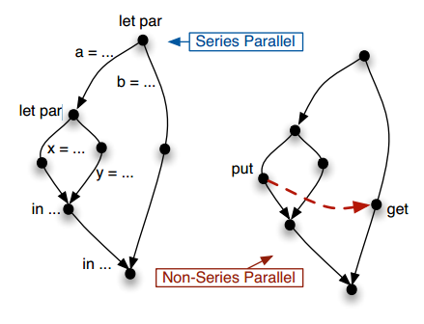
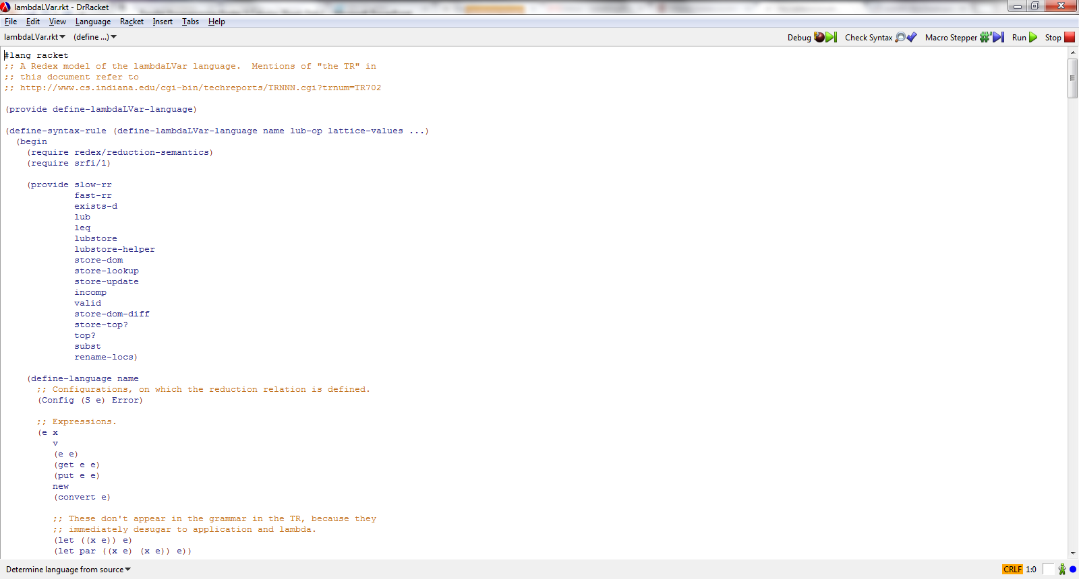

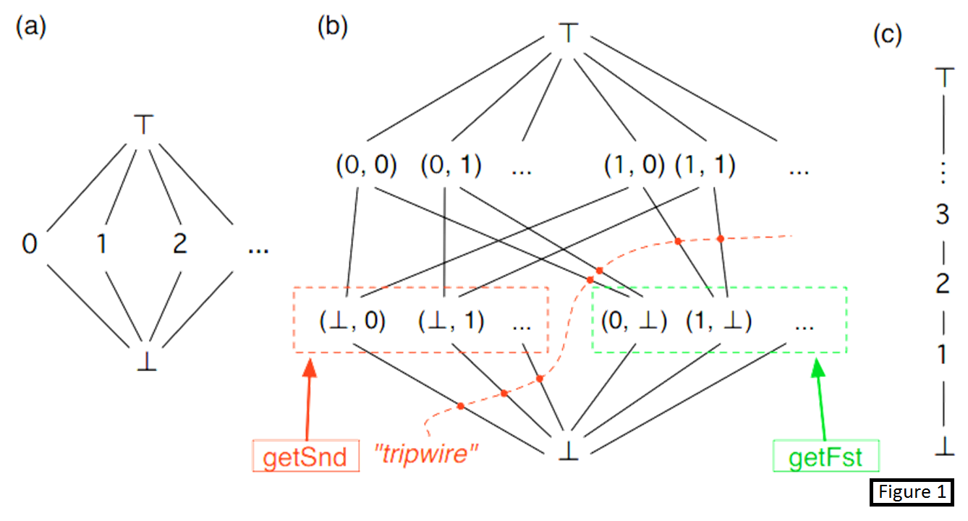
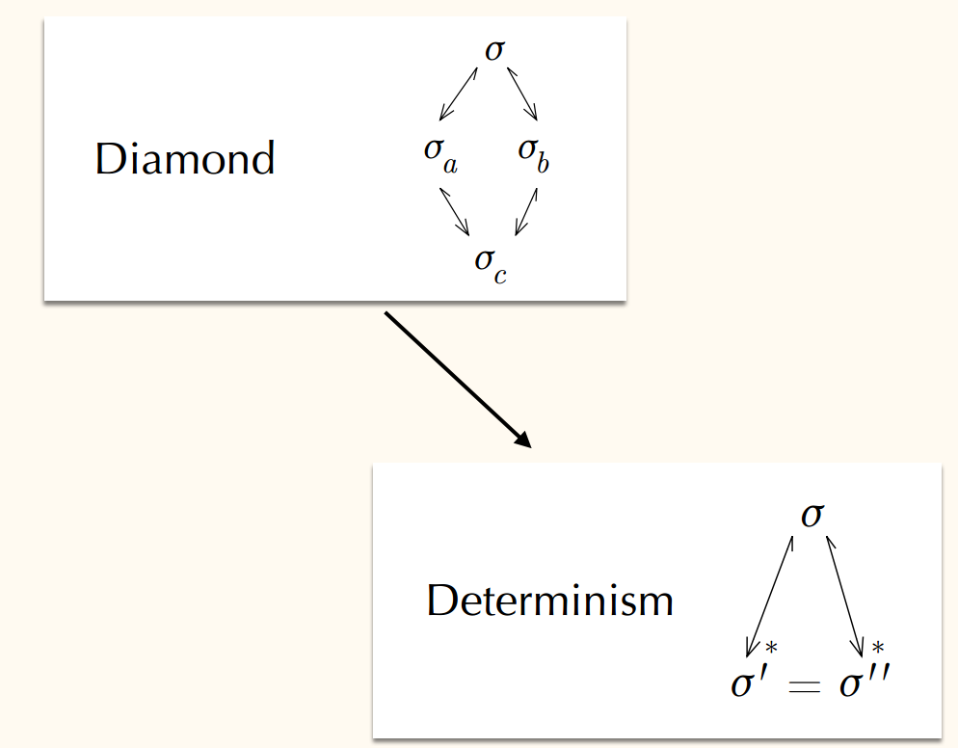

LVars for Parallel Programming
Isaiah Weating & Lindsey Kuper
School of Informatics and Computing - Indiana University
Introduction
Determinism for λ LVar
Summary
Parallel programming is a form of computation in which multiple calculations are carried out simultaneously, operating on the principle that large problems can often be divided into smaller ones, which are then solved concurrently. This allows programs to operate faster. Parallel programming without state isn’t that difficult. When you add state to the equation though, it begins to get more challenging. This begins to cause the program to become nondeterministic depending on the order of the parallel computations. A nondeterministic program could have different solutions dependent on the order which statements are called. Our goal is to create a language that will allow a program to run various operations in parallel while still remaining deterministic.
This is the part where I talk about determinism in our program based on figure 2
For some lattices, the least upper bound operation was a simple built-in function like taking the maximum of two numbers; for other lattices it was more sophisticated and required us to write our own function.
We instantiated lambdaLVar in a variety of ways, and for each instantiation, we created test suites to check if the programs we wrote were working the way we intended.
let par a = ... let par x = ... y = ... in ... b = ... in ...
let par a = ... let par x = ... Put(l) ... y = ... in ... b = ... Get(l) ... in ...
Tools Used
We developed our language in Reddex. Reddex is a programming language used for creating programming languages which is embedded in the racket language. Our development software of choice was Dr. Racket, shown below.
The Problem
Before I began working on this project, there was already an implementation of the counter lvar, figure 1c. The counter lvar keeps track of the max value that has been entered. If the user were to put in values x and y into the lvar, it would keep track of max( x, y ). If the user were to then use the get function on any value that is less than or equal to max( x, y ), it would return true. If they were to call get with a value greater than max( x, y), it would return false.
The pair lvar, figure 1b, allows for pairs of values. This lvar only allows for one value in each index. The order in which the program puts in the values isn’t important. This lvar will also allow for inputting both values in parallel. Once it has both values assigned, if the program would attempt to put another value it, the lvar would reach top which would throw an error. Being able to implement this lvar is on way of solving our problem of keeping a parallel program deterministic.
Future Work
Future work on lambdaLVar:
Automatic test generation: The flexibility of lambdaLVar means that there is always more work to do: we can create new languages with lambdaLVar, but for each new language, if we want to see if it's working in the way we intend, we have to manually write tests. In the future, we would like to exploit the random test generation features of Redex to automate some of this work for us.
Decoupling lambdaLVar from Redex: lambdaLVar programs can be cumbersome to work with because one has to write them inside the Redex framework. In the future, though, we should be able to decouple lambdaLVar programs and write them independently from Redex, using Racket's "#lang" protocol. They would still run on the Redex infrastructure, but it would be hidden from the user. Even better, we could add things like syntax highlighting. Then lambdaLVar programs would begin to "feel" more like programs, rather than just pieces of data that Redex is manipulating.
Future work on LVars in general:
There is still much work to be done to figure out effective ways of programming with LVars. We want LVar libraries to be available for use in languages beyond the special-purpose lambdaLVar language, and eventually, we want to build libraries of efficient concurrent data structures on top of LVars. (Ask Lindsey for more details on the current roadmap for LVars!)
Future work on the metatheory of LVars:
As we work out better ways to program with LVars in general, what we learn will inform the design of the next version of lambdaLVar, so we'll need to state and prove a determinism property for that new and improved language.
Figure 3
Figure 3 shows two different parallel program flow charts. The one on the left will always be deterministic since the puts and gets are done separately. The one on the right though will be nondeterministic since the put and get are evaluated in parallel. Even though the program seemingly operates simultaneously, it actually does the operations separately in a random order depending on what the system decides to do first. This could cause problems if the system decides to operate the get before the put.
Determinism for λ LVar
Summary
In this project, we worked on extending lambdaLVar, a small programming language that uses LVars. Because lambdaLVar is based on a lattice that is specified by the language user, lambdaLVar is actually not just one language, but a family of languages: instantiate lambdaLVar with one lattice and you get one deterministic parallel language; with another lattice, and you get another.
In this project we looked at some ways to instantiate lambdaLVar with new lattices. We found that to instantiate lambdaLVar with a lattice, one has to specify a "least upper bound" (lub) operation that specifies how two lattice elements should be combined together. This lub operation corresponds to how, when two threads write to a variable, the writes done by the two threads are merged together after the two threads finish running.
Contacts
Isaiah Weating --- iweating@indiana.edu
Lindsey Kuper – lkuper@cs.indiana.edu
Figure 2

